Slide 1

PLEASE TURN YOUR SPEAKERS ON FOR THIS PRESENTATION!
©2020 ARTHUR J. GALLAGHER & CO. | AJG.COM

Slide 2

Annual Enrollment Presentation
SPC Mechanical | 7/1/2020 - 6/30/2021

Slide 3

Our Plans For 2020-2021
v
MEDICAL
BCBSNC
VOLUNTARY VISION Superior Vision
TELEMED
MDLive
VOLUNTARY LIFE
Guardian
HEALTH SAVINGS ACCOUNT
HealthEquity
VOLUNTARY DISABILITY
Guardian
VOLUNTARY DENTAL
Guardian
EMPLOYEE ASSISTANCE PROGRAM (EAP)
WorkLifeMatters

Slide 4



Who is Eligible?
Eligibility Definition Medical/Dental/Vision and Life Plans
EMPLOYEE
SPOUSE
DEPENDENTS
You or your spouse’s children to age 26
regardless of student status. Life and dental plans require dependents be unmarried.
All full-time employees working 30+ hours/week who have completed their eligibility waiting period
Same or opposite sex

Slide 5
Medical Plan

Slide 6
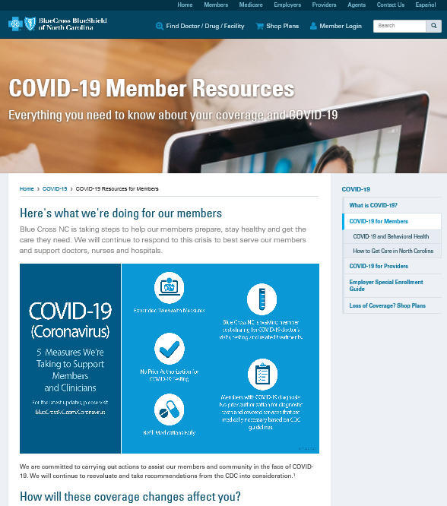
COVID-19 Resources From BCBSNC
Open Enrollment
BCBSNC has created a blog for members covered under their medical plans. It has real time updates to temporary changes to our medical plans due to Covid-19. To access the blog type https://www.bluecrossnc.com/coronavirus.
Scroll down to the box “what we’re doing for our members”.
One of these changes is BCBSNC is expanding virtual access to health care providers by covering virtual/telehealth visits including those done by phone, the same as face-to-face visits. These include appointments with primary care providers, specialists, behavioral health providers, and any NC licensed providers who can provide services via secure video or telephone.
Please call your doctor’s office and ask about virtual appointment options. These virtual visits must be medically necessary and meet the qualifying criteria.

Slide 7
2020 Medical Plan Summary of Changes
MEDICAL PLAN TEMPORARY CHANGES | For a list of temporary changes to our medical plan as a result of Covid-19, please visit https://www.bluecrossnc.com/covid-19/covid-19-resources-members. One of these changes is BCBSNC is expanding virtual access to health care providers by covering virtual/telehealth visits including those done by phone, the same as face-to-face visits. These include appointments with primary care providers, specialists, behavioral health providers, and any NC licensed providers who can provide services via secure video or telephone. Please call your doctor’s office and ask about virtual appointment options. These virtual visits must be medically necessary and meet the qualifying criteria.
MEDICAL PLAN EFFECTIVE JULY 1, 2020 | Effective July 1, 2020, our coinsurance percentage for in-network benefits will change from 80% to 70% after deductible. Our coinsurance percentages for out-of-network benefits will decrease by 10%.
MEDICAL PLAN EFFECTIVE JULY 1, 2020 | Our Telemedicine benefit through MDLive currently covers general non-emergent health consultations. Effective July 1, 2020, MDLive will include mental health consultations as a covered benefit.

Slide 8
Enrollment Process
What You Need to Do
  Our open enrollment will run from June 1 to June 22. If we do not receive any enrollment forms back from you by 5 p.m. on June 22, 2020, we will consider this to be:
  • an affirmative waiver of coverage if you are not already enrolled; or
  • a confirmation to continue coverage as set forth below if you are currently enrolled.
  To turn in changes, you may:
  • Drop off a hard copy to Human Resources or Payroll
  • Give the hard copy to your Supervisor
  • Email it to Alison.Jackson@spcmechanical.com
  • Fax it to 252-291-3731
  • Give the hard copy to Karen Newman
  You may contact the following with questions:
  Alison Jackson, HR Manager, Phone (919) 282-0131 Alison.Jackson@spcmechanical.com
  Chanel Wilson,Talent & Acquisition, Phone (919) 282-0123,chanel.wilson@spcmechanical.com
  For New Hires: The deadline to turn in your benefits paperwork will be provided by to
  you by Human Resources

Slide 9
Medical ID Cards – Open Enrollment
Please note that effective July 1, 2020, our medical group number with BCBSNC will change to 14162009 which is an eight-digit group number.
The subscriber number that is assigned to you will also change.
It is imperative that you (and your family members so please share with them) update your providers and pharmacies by sharing a copy of your new ID card.
For those of you that have auto-refill prescriptions, this is especially important. You should reach out to your pharmacies so there will not be any delays in your prescriptions being filled. The pharmacist may ask for the Rx Bin number on your id card.
Pay attention to your mail around the middle of June. BCBSNC will mail out ID cards based on your current benefit elections. In late June/early July BCBSNC will mail out a new set of ID cards for anyone making an enrollment change to the medical plan effective July 1, 2020. Please watch your mail to ensure you do not throw out the envelope with your ID card in it thinking it is junk mail.
If you have not received a hard copy of your medical ID card by July 1, 2020, you may download Blue Connect Mobile. It is a free app that allows Blue Cross NC customers to securely connect to their health plan from a mobile device and download your digital member ID card.
.

Slide 10
Medical Plan Highlights
BCBSNC
Plan Year 7/1/20 – 6/30/20 | In-Network | Out-of-Network
Preventive Care | 100% | Not Covered
Office Visit | PCP: 70%* Specialist: 70%* Virtual: 70%* | PCP: 40%* Specialist: 40%* Virtual: Not Covered
Prescription Drugs Essential Formulary | 70%* | 70%* + charge over in-network allowed amount
Emergency Room | 70%* | 70%*
Urgent Care | 70%* | 70%*
Inpatient Care | 70%* | 40%*
Outpatient Care | 70%* | 40%*
Plan Year Deductible | $3,000/$6,000 (Individual Max - $3,000) | chang$6,000/$12,000 (Individual Max - $6,000)
Out-of-Pocket Maximum | $6,650/$13,300 (Individual Max - $6,650) | $13,300/$26,600 (Individual Max - $13,300)
*Coverage provided after Deductible. Note: Individuals with other than employee only coverage will be capped at the individual deductible and out-of-pocket maximums.
Preventive Care is covered at 100% with a preventive primary diagnosis code. The service must be a covered preventive care benefit under healthcare reform. Certain over the counter preventive medications for which you have a prescription are now available at no cost. During your annual physical if anything is discussed or performed outside of the healthcare reform approved screenings, your visit may not be covered at 100%.
HIGH LEVEL SUMMARY

Slide 11

Preventive Care
PREVENTIVE CARE IS COVERED AT 100%
Routine physical exams
Well baby & well child exams
Screenings including mammograms and colonoscopies
Some Over the Counter (OTC) Medications, Supplements and contraceptives when prescribed by a provider
Visit www.bcbsnc.com/preventive for a list of covered services and OTC medications.
PREVENTIVE CARE SERVICES CAN INCLUDE MANY TYPES OF EXAMS
(subject to age/gender guidelines)
Note: Preventive care is covered at 100% with a preventive primary diagnosis code.
The service must be a covered preventive care benefit under healthcare reform.
Notes:
Do not included for GF Health Plans if they don’t cover preventive at 100%
Covered at 100%: no deductible No copayment No coinsurance 100% coverage
Regular preventive care helps to:
Reduce risk of disease and detect health problems early & Protect you from higher costs down the road
Some OTC medications and supplements will be covered at 100% when prescribed by a health care provider. Such as Folic acid for women of childbearing age, aspirin for men age 45-79 and women age 55-79 to prevent cardiovascular disease; also covers some OTC contraceptives for women

Slide 12






Right Care. Right Place. Right Savings.
With many options for getting care, how do you choose?
NURSE LINE
VIRTUAL
VISIT
CONVENIENCE CARE CLINICS
PRIMARY CARE PHYSICIAN
URGENT CARE
EMERGENCY ROOM
NurseLine connects you with registered nurses 24/7.
A virtual visit lets you see a doctor via your smartphone, tablet or computer.
Visit a convenience care clinic when you can’t see your doctor and your health issue isn’t urgent.
Your primary doctor can access your medical records and manage your medications.
Urgent care is ideal for when you need care quickly, but it is not an emergency.
The ER is for life-threatening or very serious conditions that require immediate care.
Choosing appropriate medical care
Understanding treatment options
Answering medication questions
Allergies
Bladder infections
Bronchitis
Pink eye
Rashes
Seasonal Flu
Sinus Problems
Sore Throats
Common infections (e.g. strep throat)
Minor skin conditions (e.g. poison ivy)
Vaccinations
Pregnancy Tests
Minor injuries
Ear aches
Checkups
Preventive services
Minor skin conditions
Vaccinations
General health management
Sprains
Strains
Small cuts that may need stitches
Minor burns
Minor infections
Minor broken bones
Heavy bleeding
Large open wounds
Sudden change in vision
Chest pain
Sudden weakness or trouble talking
Severe head injury
Major broken bones
No additional
cost
$
$$
$$
$$$
$$$$

Slide 13
Virtual Visits

Slide 14

What are Virtual Visits?
Convenience Factor
AVAILABILITY
Access to care 24/7.
TRAVEL
Access to care when traveling on business or vacation.
LOCATION
Access to care for rural populations, which means reduced travel time to physicians.
AFTER HOURS
Access to care after normal working hours.

Slide 15
Top 10 Virtual Visits Uses
SINUS PROBLEMS
NASAL CONGESTION
URINARY TRACT INFECTION
ALLERGIES
PINK EYE
FLU
BRONCHITIS
COUGH
UPPER RESPIRATORY INFECTION
EAR INFECTION
Notes:
Here are the top 10 Diagnosis that Virtual Visits are used for. As you can see, mainly for simple urgent care: mild to moderate conditions that have a short duration.

Slide 16
Top 10 Behavioral Health Virtual Visit Uses New Benefit Effective 7/1/20
ADDICTIONS
LIFE CHANGES
BIPOLAR DISORDERS
PANIC DISORDERS
CHILD & ADOLESCENT ISSUES
RELATIONSHIP & MARRIAGE ISSUES
DEPRESSION
STRESS
GRIEF & LOSS
TRAUMA & PTSD
Note:
Consultations are by appointment only
Wait time for initial appointment can range between 5 and 15 business days
Member may choose what type of provider they would like to engage
Behavioral health virtual visit services can be provided by psychologists, licensed social workers or family therapists in addition to licensed psychiatrists. You may request the same provider for ongoing consultations
Notes:
Here are the top 10 Diagnosis that virtual visits are used for. As you can see, mainly for simple urgent care: mild to moderate conditions that have a short duration.

Slide 17
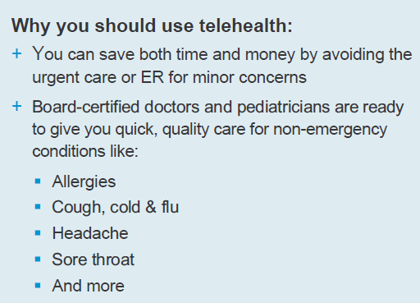



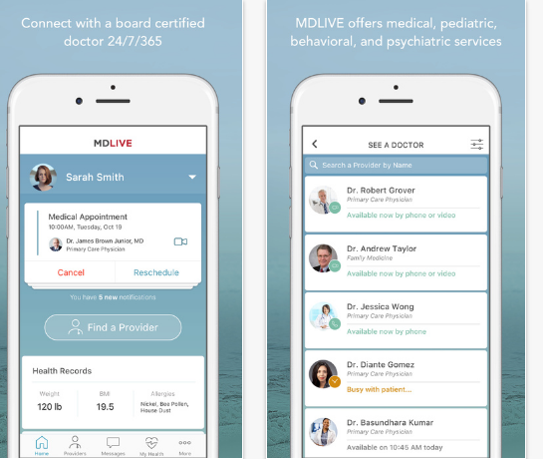

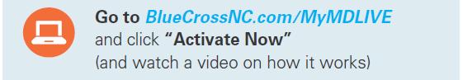



MDLIVE
MDLIVE offers medical, pediatric, behavioral, & psychiatric services.
Employees & dependents, who are enrolled in the medical plan, have access to MDLIVE.
VIDEO
PHONE
Notes:
This program is a voluntary, confidential service that provides professional counseling and referral services designed to help you with personal, job or family related problems available 24 hours a day, 7 days a week.
This program is for you and your dependent family me

Slide 18
Virtual Visits
MDLive
01
You can talk to a doctor anytime. 24/7/365 Video Consultations are available 24/7.
02
MDLive is a national network of board certified licensed physicians who can diagnose (some) illnesses, recommend treatment and prescribe medications when appropriate via phone, video or mobile app.
03
Employees and covered dependents enrolled in our medical plan are automatically enrolled in our telemedicine plan.
04
Prior to first consultation, you will need to set up your account/ profile online.
05
COST FOR EACH CONSULTATION IS COVERED AT 70% AFTER YOU
SATISFY YOUR DEDUCTIBLE
©2018 ARTHUR J. GALLAGHER & CO. | AJG.COM

Slide 19


Maximizing Your Use of HSA For RX
RESEARCH
Call around. Rx costs can vary from one pharmacy to another…even if they are right across the street from each other.
SHOP
Check with major pharmacy retailers that may offer certain drugs for $4-$10
ASK FOR GENERIC
If your doctor prescribes a Brand name drug, ask if there is a Generic option. Generics can cost considerably less than the brand name equivalent and Tier 3 meds often have a Generic/Tier 1 alternative.
KNOWLEDGE
Is your Rx available over-the counter? If so, it may save you money to purchase it OTC rather than through your insurance, but ask your doctor to write a prescription for the OTC med, so you can use your HSA funds.
Notes:
Always ask for a GENERIC drug from your doctor
Generic cost considerably less – on average 80-85% less brand name equivalent
Tier 3 often has Tier 1 Gen alternative
Costs for meds vary from pharmacy to pharmacy
Check with major pharmacy retailers that may offer certain drugs for a $4-$10 copay
Ask your doctor to write a prescription for over-the-counter medications

Slide 20
Medical Payroll Deductions
No Change from 2019
 | 2020 SEMI-MONTHLY PAYROLL DEDUCTION | 2020 WEEKLY PAYROLL DEDUCTION
Employee | $71.65 | $33.07
Employee + Spouse | $291.19 | $134.39
Employee + Child(ren) | $210.25 | $97.04
Family | $366.74 | $169.27
The amounts listed above are deducted pre-tax

Slide 21



Annual HSA Contribution Limits
ANNUAL
CONTRIBUTION LIMITS
2020
$3,550 Individual
$7,100 Family
ADDITIONAL FUNDING
Catch-up Contribution (for age 55 and over)
$1,000/year
AMOUNT OF FUNDING
Contributions above the annual limit are subject to income taxes and a 6% penalty
Members who are not considered an HSA eligible individual for the entire year may have contribution restrictions based on the last-month rule.
Visit https://www.irs.gov/publications/p969
for more information.
Notes:
The IRS determines how much you can contribute every year. Remember, you, your employer or anyone can contribute to your HSA tax-free. But -- there is an annual limit to how much you can contribute. For 2017, that amount is $3,400 for an individual and $6,750 per family. For 2018, those limits are $3,450 and $6,900, respectively. As a bonus, if you are 55 years of age or older (but not entitled to Medicare benefits), you can fund up to an additional $1,000 a year as a “catch-up” contribution to help prepare for your health care costs in retirement. If you and your spouse are both 55 or older, you can both contribute an additional $1,000 – please visit irs.gov for more details on doing two catch-up contributions in the same family.
Excess contributions are subject to income taxes and a 6% penalty. Couple of things to note here:
If anyone else contributes to your HSA, what they contribute on your behalf also counts towards your annual contribution limit.
If you were, or were considered (under the last-month rule (Dec 1)), an eligible individual for the entire year and didn’t change your type of coverage, you can contribute the full amount based on your type of coverage. However, if you weren’t an eligible individual for the entire year or changed your coverage during the year, your contribution may be limited in nature.
Now, while there is a limit on how much you can deposit into your HSA each year, there is no limit on how much you can save in your HSA over the long term.

Slide 22

HSA Contribution
You can contribute through payroll deductions, which are tax-free.
Or you can contribute directly and deduct your contributions on your tax return.
SPC Mechanical Corporation will contribute $1,500 to your HSA if you elect employee only coverage and $3,000 year for all other tiers while you are actively employed with SPC Mechanical and this is deposited quarterly.
The employer contribution is prorated for those joining the medical plan after July 1, 2020. This amount counts toward your annual contribution limit.
How can I CONTRIBUTE to my HSA?
Notes:
So how can you contribute to your HSA? You have many options. You can contribute through payroll deductions - tax free. Or you can make contributions on your own and deduct them on your tax return. Additionally, you can make periodic contributions, contribute the maximum amount in one lump sum at the beginning of the year, or contribute throughout the year as you can. Regardless of the mode or frequency of your contribution, just keep in mind that there are contribution limits for how much you can put into your HSA per year, as we had discussed earlier.

Slide 23
How You Can Use The HSA
Any money you take out of your HSA for eligible medical expenses is federal INCOME-TAX FREE
Medical plan deductibles and coinsurance
01
Use HSA dollars to pay for qualified medical expenses for your spouse or qualified tax dependents
Pharmacy, dental, vision care services
02
03
Notes:
You can use the money in your HSA to pay for “eligible medical expenses” permitted under federal tax law. That includes medical, dental and vision care and services, as well as prescription drugs, including costs that apply to your medical plan deductibles, as well as the coinsurance you pay under the plan. The HSA is a great way to pay for those Out-of-Pocket costs.
You may be surprised to know that you can apply your HSA dollars to a wide variety of expenses, including acupuncture, contact lenses, LASIK surgery, dental surgery and braces, even hearing aids. A detailed list of eligible and non-eligible medical expenses is available to you at irs.gov. Remember, if you use your HSA money to pay or reimburse for “eligible medical expenses,” the money taken out of the account is income tax-free.
In addition to using your HSA dollars for your own medical expenses, you can also use them to pay for eligible medical expenses for your spouse or dependents, even if they are not covered by your health plan.

Slide 24

Accessing Your HSA Funds
Use your HSA debit card for Rx purchases or any other service that can’t be submitted to insurance such as vision expenses.
All other services, wait until you receive your Explanation of Benefits (EOB) from BCBSNC or Guardian. This will provide you with an accurate amount of the balance owed.
How Can I Access My HSA Funds?
Submit your request for reimbursement on-line to HealthEquity and include a copy of the EOB.
Make sure you save all of your receipts and EOBs as proof of valid reimbursement. You may need them if you are audited by the IRS!

Slide 25
HSA Bank Accounts
Preferred Banks
BANK FEES
  If you use HealthEquity as your HSA Bank,
  SPC Mechanical will pay the BASIC monthly banking fee. If you use another bank, you will be responsible for their fees.
  If you decide you want hard copy bank statements in the mail from HealthEquity you will pay a monthly fee for that. If you agree to pull up your bank statements online there is no fee for bank statements.
You may choose your own financial institution for your HSA account
Your Employer will only make employer contributions to HealthEquity
ACCOUNT SET UP
You must set up your account with HealthEquity if you want to receive the employer contribution and make payroll deductions.
Your Employer will only transmit HSA funds deposited by employees via payroll deductions to HealthEquity
BCBSNC & HealthEquity are integrated making paying claims easy
Notes:
CUSTOMIZE BOLD TEXT

Slide 26
Carrier Resources

Slide 27
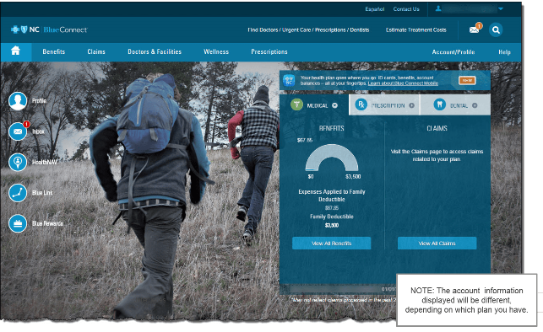
BLUECONNECTNC.COM

Slide 28
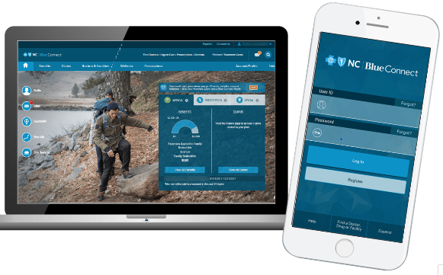
BCBSNC Website and Mobile App
Blue Connect Plus Blue Connect Mobile
Notes:
Learning more about how your health plan works is easy with Blue Connect or Blue Connect mobile. You can have your health plan information either on your computer or in the palm of your hand.
These tools allow you to securely connect to your Blue Cross of North Carolina health plan whenever you want.

Slide 29
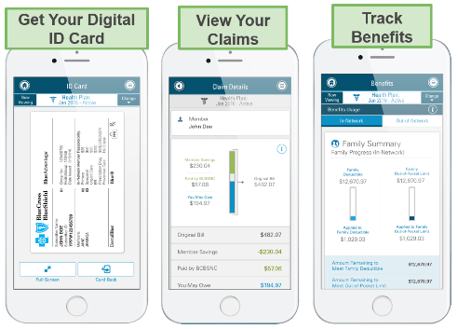

Use Blue Connect Mobile
Access Information 24/7
Everything on the mobile app is available in Spanish
Notes:
With Blue Connect Mobile you can get your digital id card, view your claims, or track you benefits, deductibles and out of pocket expenses.
You can call customer service, or send a message through the app. Fingerprint/touch ID sign in is available on certain devices.
Everything on the mobile app is available in Spanish

Slide 30
Your Dental Plan

Slide 31
Voluntary Dental Plan Highlights
Guardian
Note that you may enroll yourself and your dependents when first eligible for benefits, with a qualifying event or at annual enrollment to be considered a timely entrant.
Calendar Year Benefit Period | In-Network | Out-of-Network
Preventive Care | 100%¹
Basic Care | 80% after deductible
Major Care | 50% after deductible
Orthodontia | 50% (child only)
Calendar Year Deductible | $50 Single/$150 Family
Calendar Year Benefit Maximum | $1,000¹ + Maximum Rollover
Annual Maximum Rollover | $250 up to $1,000
Lifetime Orthodontia Maximum | $1,000
UCR Level | Negotiated Fee |  | 90th
¹Benefits paid for Preventive Care will not be applied to the Annual Maximum
Note: The cleaning and exam benefit is allowed every 6 consecutive months. Ask your dentist to schedule your next appointment
a minimum of 6 months from your last cleaning and exam
Notes:
Update Dental Carrier in first row
Remove late entrant box if not applicable
The following 2 slides reflect this table. CM can choose which one they’d rather use.

Slide 32
Dental Maximum Rollover
EXAMPLE OF YEAR ONE
  Two cleanings covered at $200 each ($400 total)
  Paid Claims are less than Paid Claim Maximum of $500
  You qualify for a $250 rollover
  You must have a service within the year and keep your claims under $500 for the calendar year to be eligible for the rollover.
  Individuals with 4th quarter effective dates will qualify for rollover the beginning of the next calendar year.
PLAN ANNUAL MAXIMUM
PAID CLAIM MAXIMUM
MAXIMUM ROLLOVER AMOUNT*
MAXIMUM ROLLOVER ACCOUNT LIMIT
*$250 is the rollover if using out-of-network providers. If using in-network providers then the rollover
amount increases to $350
Notes:
Customize based on the plans roll over amounts
Click on one of the bars, “chart tools” menu bar will appear on the ribbon and select the “Design” tab and “Edit Data”
The labels (with the dollar amounts) should automatically adjust as you fill in the data on the data sheet (excel spreadsheet).

Slide 33
Dental Payroll Deductions
No Change from 2019
 | 2020 SEMI-MONTHLY PAYROLL DEDUCTION | 2020 WEEKLY PAYROLL DEDUCTION
Employee | $16.05 | $7.41
Employee + Spouse | $33.53 | $15.48
Employee + Child(ren) | $37.94 | $17.51
Family | $52.85 | $24.39
The amounts listed above may be deducted pre-tax
Notes:
3rd option

Slide 34
Vision

Slide 35
Voluntary Vision Plan Highlights
Superior Vision
 | IN-NETWORK | OUT-OF-NETWORK ¹
Exam Frequency Lenses & Contacts Frequency Frames Frequency | 12 months 12 months 24 months
Exam | $10 Copay | Ophthalmologist: Up to $44 Allowance Optometrist: Up to $39 Allowance
Frames & Lenses | $25 Copay² | Frames: Up to $60 Allowance Single: Up to $26 Allowance Bifocal: Up to $34 Allowance Trifocal: Up to $50 Allowance Lenticular: Up to $76 Allowance
Elective Contact Lenses in lieu of Lenses & Frames | Up to $150 Allowance | Up to $100 Allowance
¹Copays apply to Out-of-Network providers for Exams, Lenses and Frames
² Frames are covered up to a $150 Allowance, plus discount on balance over allowance after copay
Notes:
Update carrier in first column
Make sure footnotes match the purchased vision exhibit
Copay footnote is on Out of Network Benefit- only really applies mostly for VSP Plan

Slide 36
Vision Payroll Deductions
No Change from 2019
 | 2020 SEMI-MONTHLY PAYROLL DEDUCTION | 2020 WEEKLY PAYROLL DEDUCTION
Employee | $3.21 | $1.48
Employee + Spouse | $6.42 | $2.96
Employee + Child(ren) | $7.38 | $3.40
Family | $11.36 | $5.24
The amounts listed above may be deducted pre-tax
Notes:
3rd option

Slide 37
Life Insurance
Short Term Disability
Long Term Disability

Slide 38
Voluntary Life Insurance Plan Highlights
Special Enrollment Period 7/1/2020
Guardian
Voluntary Term Life is available for purchased on the employee, spouse, and dependents.
Coverage must be purchased on the employee in order to purchase coverage for a spouse and/or dependent.
Guardian is offering a one-time special enrollment period, effective 7/1/2020, for employees who don’t have voluntary life coverage or who wish to increase their coverage amount. The employee and spouse limits have been increased for richer coverage so the new benefit maximums and guarantee issue levels are available effective 7/1/2020. Action is needed if you want to change your current election or sign up for the first time.
Employee voluntary life coverage - employees may purchase in $10,000 increments up to $100,000;
$100,000 is the guarantee issue to age 64, $50,000* is the guarantee issue for ages 65-69 and $10,000* is the guarantee issue age 70+. If you were previously denied voluntary life coverage, the denial stands.
Spouse voluntary life coverage - employees may purchase this benefit on a spouse in $5,000 increments up to a benefit maximum of $50,000*. You may purchase $20,000 in coverage which is the guarantee issue for spouses to age 64, and for spouses ages 65 to 69, the guarantee issue is $10,000.
Note: The spouse voluntary life coverage terminates when the spouse turns 70; the spouse rates are based on the employee’s age. If your spouse was previously denied voluntary life coverage, the denial stands.
If you are purchasing dependent life coverage for your child(ren) the maximum benefit amount and guarantee issue is $10,000. This benefit is available to unmarried children ages 14 days to age 26.
The employee’s age as of 7/1/2020 will be the age you will be billed until 7/1/2021 if you move to another age band.
*If you and/or your spouse wish to purchase more than the guarantee issue, you will need to complete an evidence of insurability form.
Notes:
Remove AD&D if group doesn’t offer Voluntary AD&D

Slide 39
Voluntary Life Insurance Plan Highlights
New Hires
Guardian
VOLUNTARY LIFE AND AD&D**
  100% Employee paid
  Employee* - $10,000 increments up to $100,000; $100,000 guarantee issue to age 64,
  $50,000 guarantee issue age 65-69; $10,000 guarantee issue age 70+
  Spouse* - $5,000 increments up $50,000; Guarantee Issue: $20,000 to age 64; Guarantee issue: $10,000 (ages 65-69)
  Note: Spouse life benefits terminate when the spouse turns 70
  The spouse rates are based on employee’s age
  Dependents – Benefit maximum and Guarantee Issue is $10,000 (14 days to age 26 unmarried)
  *An age reduction schedule applies
  **Evidence of insurability (EOI) is required if enrolling after you are first eligible
Notes:
Remove AD&D if group doesn’t offer Voluntary AD&D

Slide 40
Voluntary Disability Plan Highlights
Guardian
VOLUNTARY SHORT TERM DISABILITY
VOLUNTARY LONG TERM DISABILITY
100% Employee paid
100% Employee Paid
Benefit begins after 7 days of disability for injury or illness
Benefit begins after 180-day elimination period
Weekly benefit is 60% of your salary to a maximum of $800
Monthly benefit is 60% of your salary to a maximum of $5,000
Benefit period is 26 weeks including 7 day elimination period
Benefit period is to Social Security Normal Retirement Age
  Evidence of insurability (EOI) is required if enrolling after you are first eligible
Notes:
Update Header to reflect correct carrier
Remove EOI reference if plan is 100% ER paid/EOI only for voluntary or contributory coverages

Slide 41
Employee Assistance Program

Slide 42
Employee Assistance Program (EAP)
Having Financial Issues?
Grieving a Loss?
Tension in Household?
Seeking Legal Assistance?
All employees have access to EAP phone support and website resources
For employees enrolled in Guardian’s dental,
short-term disability or long-term disability you also have access to 3 face-to-face meetings
WorkLifeMatters
800.386.7055
www.ibhworklife.com
Notes:
This program is a voluntary, confidential service that provides professional counseling and referral services designed to help you with personal, job or family related problems available 24 hours a day, 7 days a week.
This program is for you and your dependent family me

Slide 43
Retirement Plan
401(K)

Slide 44
Retirement Plan - 401(K)
AXA/Equitable
  The 401(k) program enables employees to save for retirement on a
  pre-tax or post-tax basis
  Eligibility: 90 days of service meeting minimum age requirement of age 20
  Employee voluntary contributions may receive an employer discretionary match up to 5%
  Examples: If Employee Contributes 3%, SPC will contribute 3%
  If Employee Contributes 6%, SPC will contribute 5%

Slide 45
Enrollment Action

Slide 46
Now Is The Time To Enroll
Open Enrollment
Deadline:
Please return your forms to us by
JUNE 22ND!
New Hires:
Complete and return to HR by date indicated
After this period, benefit changes can only be made if you experience a qualifying event.
Regardless of the reason, you must enroll within 30 days of the event!
MARRIAGE
ADOPTION
ELECTION CHANGE EVENTS INCLUDE
DIVORCE
BIRTH
CHANGE IN OTHER EMPLOYER COVERAGE
98

Slide 47
A
Q
This document is an outline of the coverage proposed by the carrier(s), based on information provided by your company. It does not include all the terms, coverages, exclusions, limitations, and conditions of the actual contract language. The policies themselves must be read for those details. The intent of this document is to provide you with general information about your employee benefit plans. It does not necessarily address all the specific issues which may be applicable to you. It should not be construed as, nor is it intended to provide, legal advice. Questions regarding specific issues should be addressed by legal counsel who specialize in this practice area.

